Slide 1
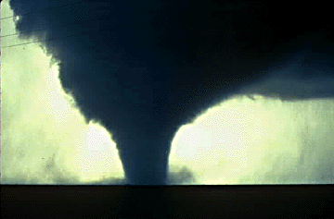
TORNADOES

Slide 2
Do Now
When the bell rings, we’re going to be watching a clip from “Storm Chasers.”
While you’re watching, think about what you already know about tornadoes.
Have you ever experienced a tornado?
Do you have family members who have?
What do you think about these guys?
http://www.youtube.com/watch?v=06YyI7crOy0

Slide 4
Tornadoes
Tornadoes are caused by warm, moist air in advance of eastward-moving cold fronts
The intense spinning of a tornado is partly the result of the updrafts and downdrafts in the thunderstorm
http://www.mnn.com/earth-matters/translating-uncle-sam/stories/what-causes-tornadoes

Slide 5
Tornado Facts
Winds can exceed 300 mph!!!
Around 1,000 occur on average each year in the U.S.
Kill 80, injure 1,500 people each year on average
Can have a path up to a mile wide!!!
Can occur any time of the year, but peak during the spring (March-June)
Occur most frequently in the central U.S. in a region nicknamed “Tornado Alley”

Slide 6
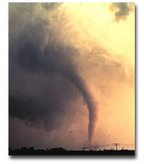
What Exactly Is A Tornado?
Violently rotating column of air (Vortex) extending from a thunderstorm to the ground

Slide 7
How Do They Form?
Actually, no one knows for sure!
But…We have a pretty good idea…

Slide 8
Step 1
Before a t-storm, a change in wind direction and an increase in speed forms an invisible, horizontal spinning effect in the lower atmosphere (at the base of the storm)

Slide 9
Step 2
Rising air within the t-storm (updrafts) tilts the rotating air from horizontal to vertical

Slide 10
Step 3
Vertical rotation now extends 2-6 miles up into the t-storm. Now a tornado may form and extend from this area of rotation to the ground.

Slide 11
How Strong Are Tornados?
Strength is measured by the Fujita Scale...
F0 = weakest, F5 = Strongest

Slide 12
Are Most Tornados Strong?
All tornados are potentially deadly, but most are actually relatively weak (74%)…!
Only 1% of all tornados fall in the F4 – F5 range

Slide 13
What’s Up With Xenia, OH?
Xenia has been the target of several major tornados down through the years…
Most recent: Sept. 2000
Most Notable: April 3, 1974

Slide 14
Sept. 2000 Damage
Where do you think this Tornado ranked on the Fujita Scale?

Slide 15
April 3, 1974 Tornado

Slide 16
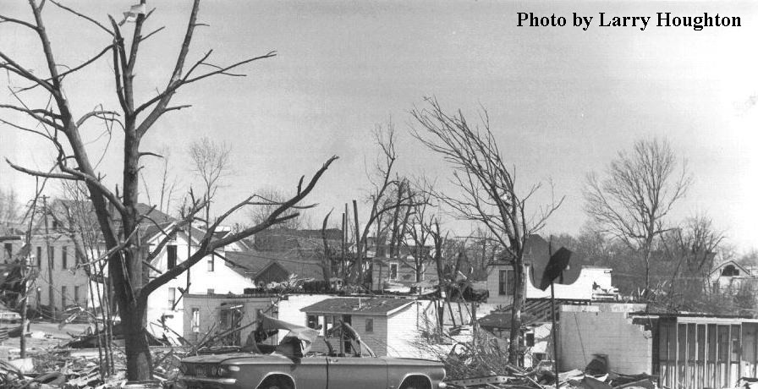
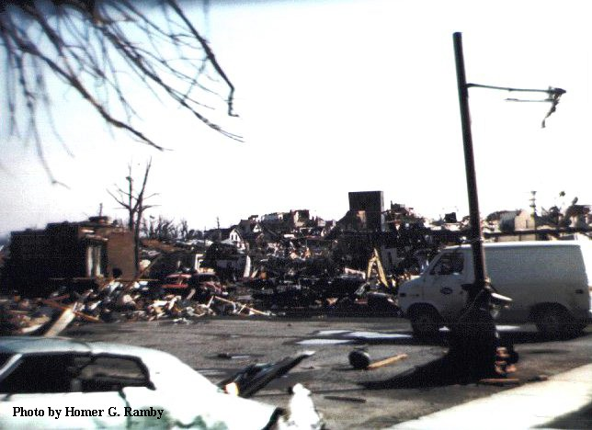
April 3, 1974 Damage
Where do you think this tornado ranked on the Fujita Scale?

Slide 17
Answers
Sept. 2000 = F3-F4 (Severe/Devastating Damage; Winds of 200-260 mph)
April 1974 = F5 (Incredible Damage; Winds of 260-300+ mph!!!)

Slide 18
Quick Review
Are most tornados strong or weak?
Which would cause more damage, an F1 or an F5 tornado?
During which season do most tornados occur in the U.S.?
What is the nickname of the region in the U.S. where many tornados occur?
What is used to classify the intensity of tornados?
Bonus**: How do experts think tornados form?

Slide 19
Tuscaloosa Personal Account
I will pass out class copies of a First Hand Account of the Tuscaloosa Tornado from 2011.
We will read these as a class and discuss.

Slide 20
Tuscaloosa Tornado
https://www.youtube.com/watch?v=a_MuaWDg5Z0
http://www.youtube.com/watch?v=sA7TKSHJ_wM
https://www.youtube.com/watch?v=HdmTpsyQinM
https://www.youtube.com/watch?v=Grhqbmk-79U
http://www.youtube.com/watch?v=TIx26tN6pCk&feature=related

Slide 21
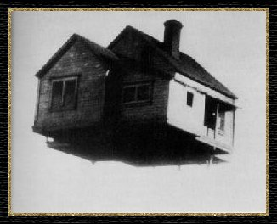
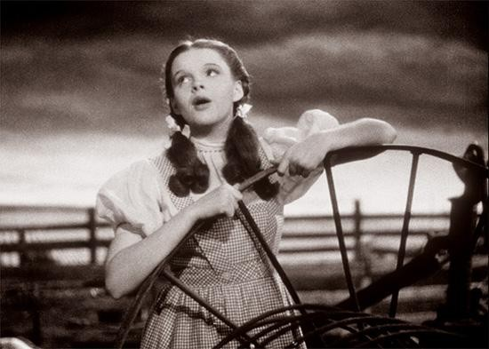
THE END

