Slide 1
DNA Deoxyribonucleic Acid
Mrs. Ward’s Science Class
Ridge Road MS

Slide 2
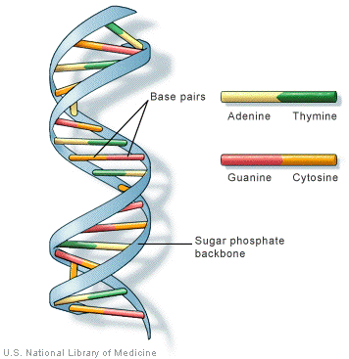
Warm-Up Page 127
Sketch the following diagram of DNA in your science notebook…

Slide 3
Announcements:
Welcome Back! I hope you had a wonderful & restful weekend!
Grades/Third Quarter
Set Up Notebooks
Quiz Wednesday on DNA

Slide 4
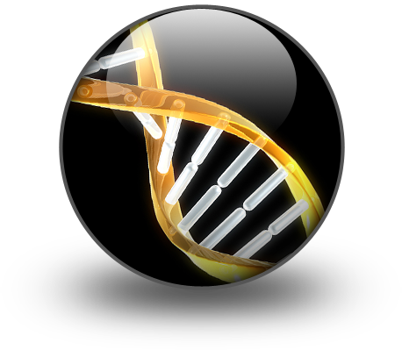
What is DNA???
DNA is the common name for
DEOXYRIBONUCLEIC ACID
DNA is the genetic material found in all living cells
The majority of DNA is located within the nucleus of EACH and every cell in the body
http://www.youtube.com/watch?v=eOvMNOMRRm8&feature=player_embedded#!

Slide 5
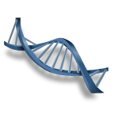
What is the structure of DNA?
DNA structure was discovered by James Watson and Francis Crick in 1953
Described as a “DOUBLE HELIX”
Like a twisted ladder.
The scientists wrote a book by the same name

Slide 6
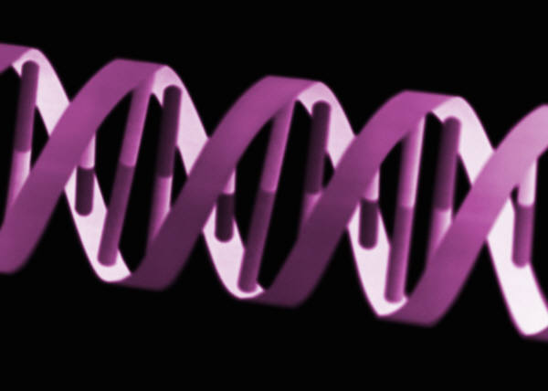
DNA is:
Made up of:
a sugar-phosphate backbone
(Sides of the DNA)
Four chemical Bases (that match up)
ADENINE, GUANINE, CYTOSINE, and THYMINE
AGCT (RUNGS OF THE LADDER)
A always pairs with T
G always pairs with C
This is how DNA is able to split and replicate and keep the same genetic material. (The cells match up the pairs like a puzzle!)

Slide 7
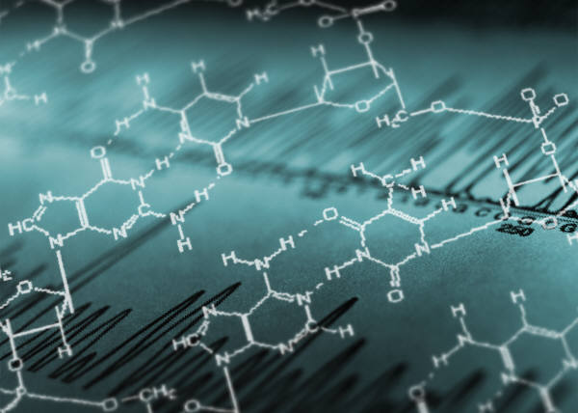
Another video…about base pairs!
http://www.youtube.com/watch?NR=1&feature=endscreen&v=5raJePXu0OQ

Slide 8
Brain Pop!!! DNA
http://www.brainpop.com/science/cellularlifeandgenetics/dna/

Slide 9
EXIT TICKET
Where is DNA located?
What is the name of the structure?
APPLY YOUR KNOWLEDGE:
Why might DNA be important in paternity testing?

