Slide 1
Cell Specialization
Anna Ward
Ridge Road MS

Slide 2
Science Starter: Scrap piece of paper
In which layer of the atmosphere would I find the ozone layer?
Which gas is the most abundant in Earth’s atmosphere?
What type of clouds associated with thunderstorms?
High pressure will result in what kind of weather?
As you increase in altitude, what happens to air pressure?

Slide 3
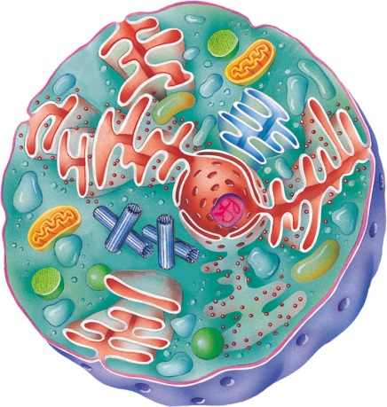
Announcements & Agenda
Science Fair Projects
Test grades: What can I do to improve?
Watch the video
Complete the homework
Agenda
Take notes on Organization of Life
Video and Questions
Complete Class Activity
Independent Activities:
Cell Specialization Chart
Cells R Us Worksheet
DE Life in a Fishbowl

Slide 4
Brain Pop! Cell Specialization
http://www.brainpop.com/health/geneticsgrowthanddevelopment/cellspecialization/

Slide 5
Video Questions (Page 100) Leave space to answer
What kinds of things do complicated creatures (people, cats, dogs) do that simple-one celled organisms can’t do? What things are similar?
Describe a sponge.
What is tissue?
What forms an organ?
Name the organs of the human digestive system.

Slide 6
Cells, Tissues, Organs, Organ Systems
Organization of Life
http://app.discoveryeducation.com/mycontent#mode=MyContent&view=Favorites&guid=c9453417-9b06-4cb7-9799-ffada4fefec5
Cell Specialization
http://app.discoveryeducation.com/mycontent#mode=MyContent&view=Favorites&guid=c9453417-9b06-4cb7-9799-ffada4fefec5

Slide 7
The organization of Organisms (Page 100)
Cell
Tissue
Organ
System
Organism

Slide 8
Cells (Cornell Style, Page 101)
You all know what a cell is by now!
A Cell is the smallest unit of life!!!
In some cases it can exist on its own, in other cases it needs to live with other cells
Analogy: If CMS were an organism, each classroom at RMMS would be a cell)….Just like during Club Cell!!!

Slide 9
Tissue (Cornell Style, Page 101)
Tissue – a group of cells that are structurally similar and perform the same function
Ex. muscle, nerve, blood
Analogy: Each of the Wolfpack classrooms together would make up tissue if RRMS was an organism.

Slide 10
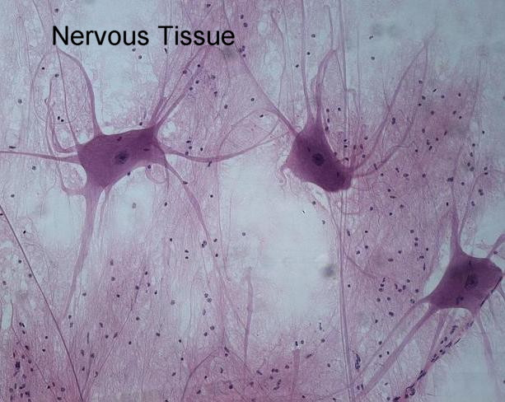

Slide 11
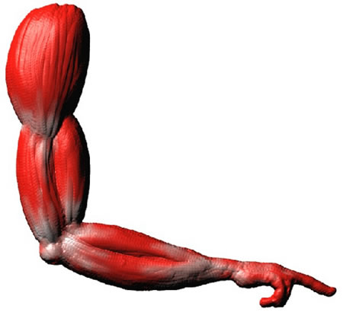
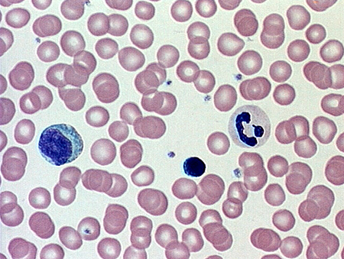
blood
Muscle tissue

Slide 12
Types of tissue (Cornell Style, Page 101)
Epithelial tissue – covers body surfaces and lines body cavities
Connective tissue – supports other body tissues and binds tissues and organs together
Ex. tendons, ligaments
Muscle Tissue – tissues specialized for contraction
Ex. skeletal, smooth, cardiac

Slide 13
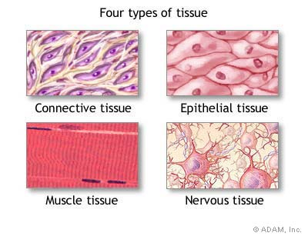

Slide 14
Torn knee ligaments
http://www.youtube.com/watch?v=92ifz2qqtm8

Slide 15
Organ (Cornell Style, Page 101)
Organ – a group of tissues that work together to form a specific function
Ex. Stomach
Analogy: If RRMS was an organism, all of the tissues (Wolfpack, Vikings, Pirates, and Wildcats’ classrooms) would each be an organ.
Eighth grade, Sixth grade, and electives would all be organs as well

Slide 16
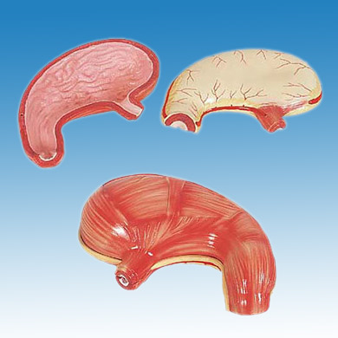

Slide 17
Organ System (Cornell Style, Page 101)
Organ System – group of organs that work together to perform a specific function
Ex. digestive system
Analogy: The entire building of RRMS would be an organ system.

Slide 18
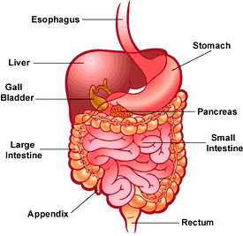

Slide 19
Card Activity
You have each been assigned a cell card.
We are going to group into systems, tissues, organs, and systems, and an organism.

Slide 20
Independent Work:
Must Do’s:
Read “Life in a Fishbowl” and complete 3/2/1 IN COMPLETE SENTENCES (on bottom of Page 101)
3 Things you already knew
2 Things you learned
1 Lingering Question
Complete Cells R Us Sheet (attach on Page 102)
Cell Specialization Chart
Get a copy of the Cell Book
Create a chart on Page 103 (See board for template)
May Do’s
Student Data Trackers and Conferencing
Vocabulary
Update Notebook and Table of Contents

Slide 21
Exit Ticket

