Slide 1
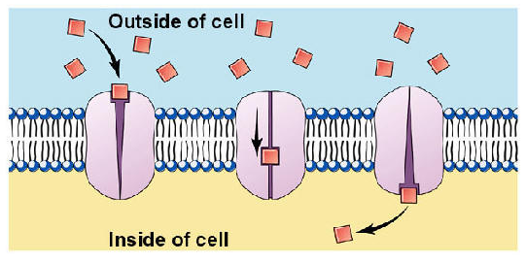
Science Starter (Page 82) (half page and LABEL AS Cell Membrane Notes)

Slide 3
Cell Membranes (page 82)
What is a Cell Membrane?
It is a layer that allows materials inside and outside the cell.
For example, it allows nutrients & oxygen to enter into the cell, and carbon dioxide waste to leave.
Cell membranes are semi-permeable
semi-permeable means that some things may enter the cell, but others cannot.

Slide 4
Why is this important?
Cell membranes are made of very thin layers of material and allow small molecules like Oxygen, water, Carbon Dioxide, Ammonia, Glucose, amino-acids etc. to pass through. But they do not allow larger molecules like sucrose, protein etc. to pass through.
Cells are “smart” enough to allow for certain things to pass through, but not larger things like genetic material.
This happens because of the composition of the cell membrane. (It is made up of a fatty material that repels water and certain fluids)

Slide 5
AKA….
You may also see the cell membrane referred to as the plasma membrane.

Slide 6
http://www.youtube.com/watch?NR=1&feature=fvwp&v=Rl5EmUQdkuI
A video

Slide 7
So I promised….
A lab!
BUT remember, if you guys are not meeting expectations, you will get a strike.
Regardless of whether you get a strike during the lab, the lab will cease once you are at 5 strikes.
Today we are going to be looking at how a cell membrane and bubbles are similar.
Before we do that though, we need to create a few things for our lab.

Slide 8
I will be giving you…
2 straws
One piece of string
One piece of string formed into a circle.
A plastic knife that you will NOT be stabbing each other with.
A paper clip…
WHEN I TELL YOU TO:
You will:
Put the cotton string through the straws.
Once that is done, you will then knot the string and have the straws form a square.

Slide 9
Cell membranes are flexible
WHEN I TELL YOU TO:
You will dip your straw device into the bubble solution.
Looking at the bubble solution on your straws, you will test the flexibility of the bubbles.
ANSWER:
Is the bubble flexible?
How do you think that this is able to apply to our cells.

Slide 10
Lab…
Label the top of page 83 “Cell Membrane Bubble Lab”
WRITE and answer the questions…below
Cell Membranes are flexible….
Is the bubble flexible?
How do you think that this is able to apply to our cells.

Slide 11
Membranes are Self-Sealing
WHEN I TELL YOU TO:
Stick the following objects through the membrane:
Straightened paperclip
Soap coated straightened paper clip
Your finger
Soap coated finger
Observe what happens to the membrane when you remove each object as well. You can even try your entire arm!
ANSWER:
What objects were able to pass through the membrane without breaking it?
Why do you think that it is important that membranes are able to self seal themselves?

Slide 12
Write and answer the following questions
Cell membranes are self-sealing…
What objects were able to pass through the membrane without breaking it?
Why do you think that it is important that membranes are able to self seal themselves?

Slide 13
Transport proteins
WHEN I TELL YOU TO:
Take the straw device and the circle of string I gave you.
Carefully stick it onto the membrane.
Pop the inside of the string circle.
Stick your finger in the pore created by the circular thread and move it around the membrane.
ANSWER:
What happened when you placed the string circle into the membrane?
Why do you think this happened?

Slide 14
Write and answer the following questions
Transport Proteins
What happened when you placed the string circle into the membrane?
Why do you think this happened?

Slide 15
Cell Division
WHEN I TELL YOU TO:
Take a straw and dip the end into the soap solution.
Hold it just above the surface and gently blow to create a bubble.
Take the knife, wet it with soap solution, and cut the bubble in half so that you create another layer across the middle and form two bubbles.
Now cut both of these bubbles in half.
ANSWER:
What just happened?
Why do you think this is important for our cells?

Slide 16
Cell Division
What happened when you cut the bubble with the knife?
Why do you think this is important for our cells?

